Slide 1
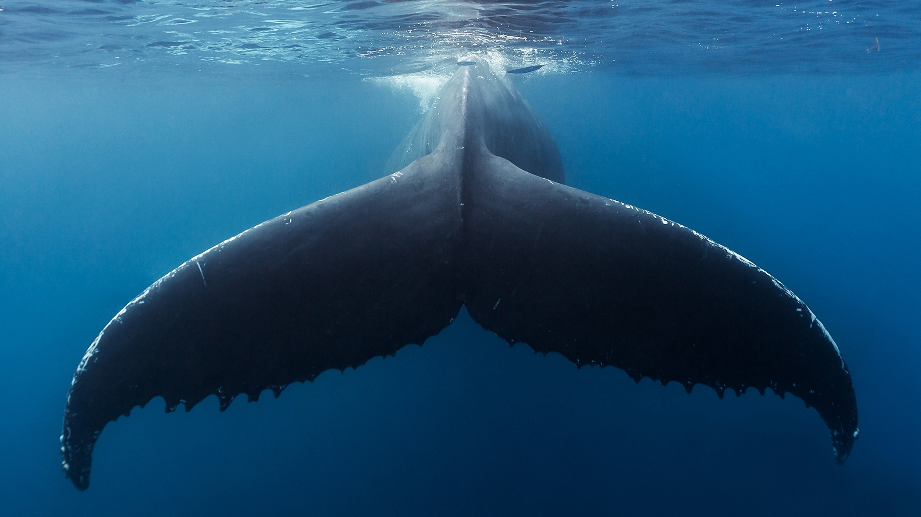
What if
fossil free is the solution?
2021 April
Andreas Drugge

Slide 2







Safety first
Personal protective equipment
Emergency exit
Alarms and assembly point
What is your reason to be safe?
Defibrillator and first aid kit
Fire extinguisher
Emergency number
Notes:
Have you seen something unsafe on your way to this presentation?

Slide 3



BillerudKorsnäs in short
Net sales approx.
(2020)
EBIDTA approx.
(2020)
57%
Product area Board
Share of net sales
23,9
2,7
8
Production units
Billion SEK
Billion SEK
32%
Product Area Paper
Share of net sales
Beetham
Frövi
Rockhammar
Gruvön
Gävle
Karlsborg
Pietarsaari
Skärblacka
11%
Solutions and other
Share of net sales
4 400
Number of employees

Slide 4
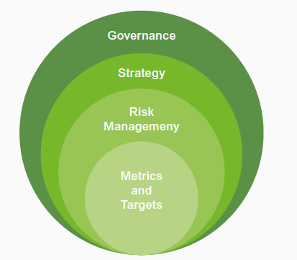
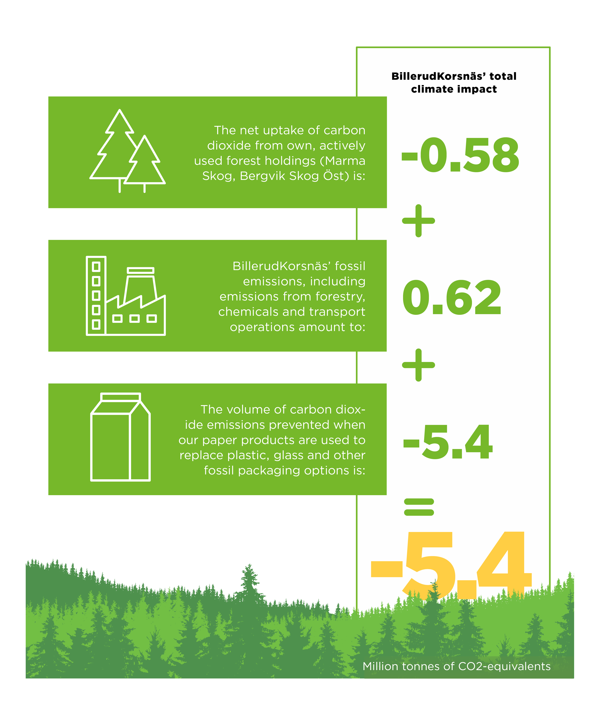

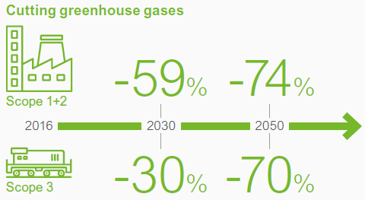
Climate initiatives
2013
2016- 2018
2020

Slide 5

Climate targets aligned with science
CO₂-targets approved to be in line with the Paris Agreement
Scope 1 & 2*: -59% by 2030
Scope 3*: -30% by 2030
Some of our results in 2020*
-10%
CO₂ reduction from production
97.4% fossil free (Scope 1 & 2)
2%
CO₂ increase for upstream transports (Scope 3)
-17%
CO₂ reduction on purchased chemicals (Scope 3)
-24%
CO₂ reduction on downstream transports (Scope 3)
*Base year 2016

Slide 6
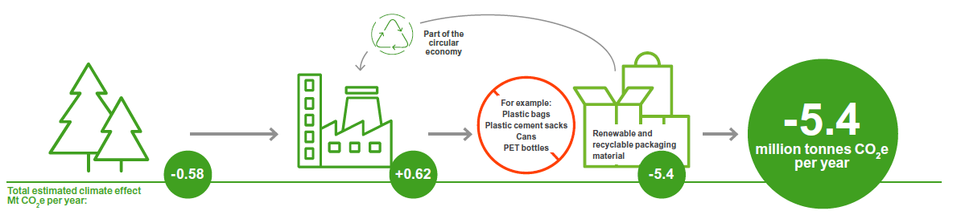
Total climate effect

Slide 7
Thanks!
Andreas Drugge Sustainability Manager

